Slide 1
Global business environment and nepalese business

Slide 2
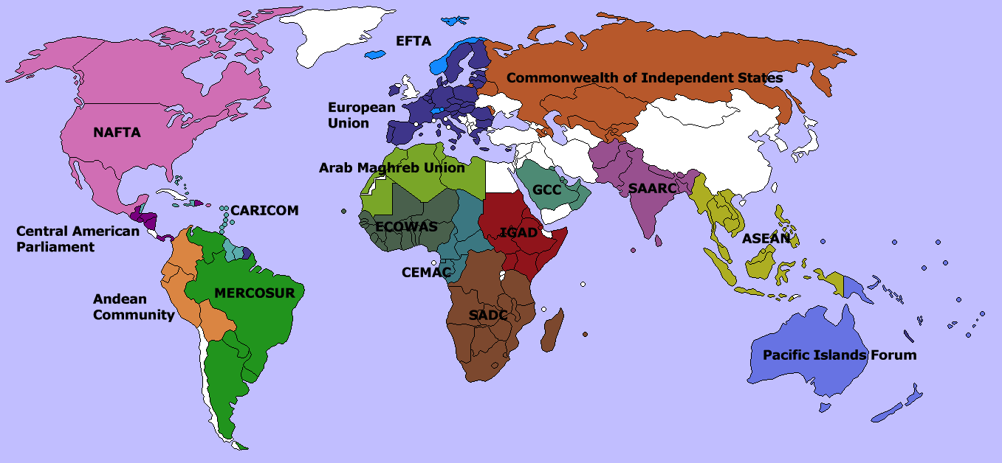
Regional grouping or integration
Regional Integration is a process in which neighboring countries enter into an agreement in order to upgrade cooperation through common institutions and rules.
The objectives of the agreement could range from economic to political to environmental, although it has typically taken the form of a political economy initiative where commercial interests are the focus for achieving broader socio-political and security objectives, as defined by national governments.

Slide 3
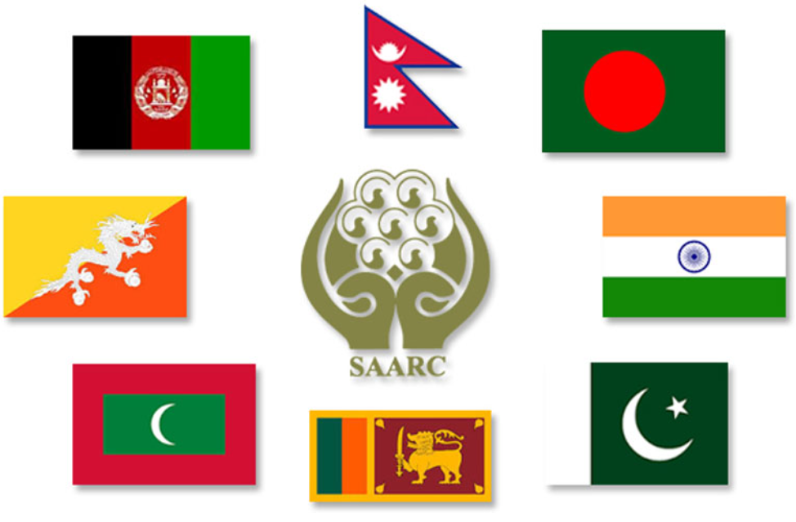
South Asian association for regional cooperation (saarc)
The South Asian Association for Regional Cooperation (SAARC) was established with the signing of the SAARC Charter in Dhaka on 8 December 1985.
SAARC was founded by seven states in 1985. In 2005, Afghanistan began negotiating their accession to SAARC and formally applied for membership in the same year.
SAARC comprises of eight Member States: Afghanistan, Bangladesh, Bhutan, India, Maldives, Nepal, Pakistan and Sri Lanka.
The South Asian Association for Regional Cooperation (SAARC) is the regional intergovernmental organization and geopolitical union of states in South Asia.

Slide 4
Objectives of saarc
To promote the welfare of the peoples of South Asia and to improve their quality of life
To accelerate economic growth, social progress and cultural development in the region and to provide all individuals the opportunity to live in dignity and to realize their full potentials
To promote and strengthen collective self-reliance among the countries of South Asia
To contribute to mutual trust, understanding and appreciation of one another's problems
To promote active collaboration and mutual assistance in the economic, social, cultural, technical and scientific fields
To strengthen cooperation with other developing countries
To strengthen cooperation among themselves in international forums on matters of common interests
To cooperate with international and regional organizations with similar aims and purposes.

Slide 5
SAArc preferential trade arrangement (SAPTA)
The SAARC Preferential Trading Arrangement (SAPTA) reflected the desire of the Member States to promote and sustain mutual trade and economic cooperation within the SAARC region through the exchange of tariff concessions.
The idea of liberalizing trade among SAARC countries was first mooted by Sri Lanka at the sixth Summit of the South Asian Association for Regional Co-operation (SAARC) held in Colombo in December 1991.

Slide 6
Contd…
Main components
Tariff
Para Tariff
Non Tariff
Direct Trade Measures
SAPTA specified four negotiating approaches namely, product by product basis, across the board tariff reduction, sectorial basis and direct trade measures. However it was agreed that tariff concessions would initially be negotiated on a product - by- product basis.
The agreement also provides for negotiation of tariff concessions to be an ongoing process. The SAPTA envisages that concessions on tariff para-tariff and non tariff measures will be negotiated step -buy step improved and extended in successive stages.

Slide 7
basic principles and objectives of sapta
Step by step negotiations and periodic reviews so as to improve and extend the preferential trade arrangement, in stages
Inclusion of all products, manufactures and commodities in their raw semi- processes and processed forms
Special and favorable treatment to Least Developed Contacting States
The objective of the SAPTA is to promote and sustain mutual trade and the economic co-operation among the member states through exchange of trade concessions. SAPTA therefore is the first step towards higher levels of trade and economic co-operation in the region.

Slide 8
South Asian free trade area (SAFTA)
The South Asian Free Trade Area (SAFTA) is the free trade arrangement of the South Asian Association for Regional Cooperation (SAARC).
The agreement came into force in 2006, succeeding the 1993 SAARC Preferential Trading Arrangement. SAFTA signatory countries are Afghanistan, Bangladesh, Bhutan, India, Maldives, Nepal, Pakistan and Sri Lanka.

Slide 9
Objectives of SAFTA
eliminating barriers to trade in, and facilitating the cross-border movement of goods between the territories of the Contracting States;
promoting conditions of fair competition in the free trade area, and ensuring equitable benefits to all Contracting States, taking into account their respective levels and pattern of economic development;
creating effective mechanism for the implementation and application of this Agreement, for its joint administration and for the resolution of disputes;
establishing a framework for further regional cooperation to expand and enhance the mutual benefits of this Agreement.

Slide 10
Principles of safta
SAFTA will be governed by the provisions of this Agreement and also by the rules, regulations, decisions, understandings and protocols to be agreed upon within its framework by the Contracting States;
The Contracting States affirm their existing rights and obligations with respect to each other under Marrakesh Agreement Establishing the World Trade Organization and other Treaties/Agreements to which such Contracting States are signatories;
SAFTA shall be based and applied on the principles of overall reciprocity and mutuality of advantages in such a way as to benefit equitably all Contracting States, taking into account their respective levels of economic and industrial development, the pattern of their external trade and tariff policies and systems;
SAFTA shall involve the free movement of goods, between countries through, inter alia, the elimination of tariffs, para tariffs and non-tariff restrictions on the movement of goods, and any other equivalent measures;
SAFTA shall entail adoption of trade facilitation and other measures, and the progressive harmonization of legislations by the Contracting States in the relevant areas;
The special needs of the Least Developed Contracting States shall be clearly recognized by adopting concrete preferential measures in their favor on a non-reciprocal basis.

Slide 11

Bay of Bengal initiative multi-sectoral technical and economic corporation (bimstec)
The Bay of Bengal Initiative for Multi-Sectoral Technical and Economic Cooperation (BIMSTEC) is a regional organization that was established on 06 June 1997 with the signing of the Bangkok Declaration.
Initially known as BIST-EC (Bangladesh-India-Sri Lanka-Thailand Economic Cooperation), the organization is now known as BIMSTEC and comprises seven Member States with the admission of Myanmar on 22 December 1997, and Bhutan and Nepal in February 2004.
On 06 June 1997, representatives of the Governments of Bangladesh, India, Sri Lanka, and Thailand came together in Bangkok, and signed the ‘Declaration on the Establishment of the Bangladesh–India–Sri Lanka–Thailand Economic Cooperation (BIST-EC)’

Slide 12
Objectives of bimstec
To create an environment for ensuring quick economic growth in the South Asian and South-East Asian countries.
To promote the atmosphere of equality and partnership in the region.
To ensure dynamic and mutual cooperation, especially in the areas that are of common interest to the member countries.
To create an environment for ensuring expeditious economic growth in the South Asian and South-East Asian countries.

Slide 13
Regional grouping issues of Nepalese business
Affect domestic industries
increase competition
Create unemployment
Decline national expertise
Minimize domestic investment
Outflow of capital
Ignore environment
Unfair competition
Transit facility
Special benefit to Nepal

Slide 14
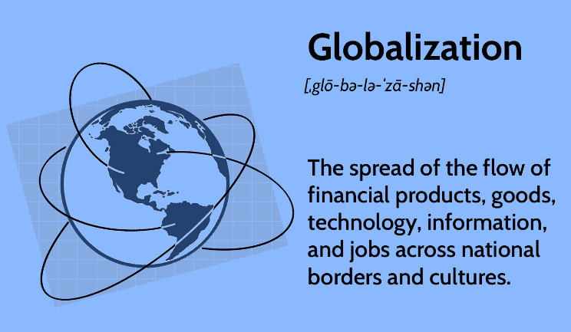
Globalization
Today, as the world becomes more connected thanks to globalization, the duties of HRM, too, have changed.
As our planet has become increasingly connected through technology and communication, this phenomenon has inevitably made its mark on various facets of business operations. Values, Symbols and beliefs differ among cultures.
Globalization has opened new areas or ways of opportunities if managed properly.

Slide 15
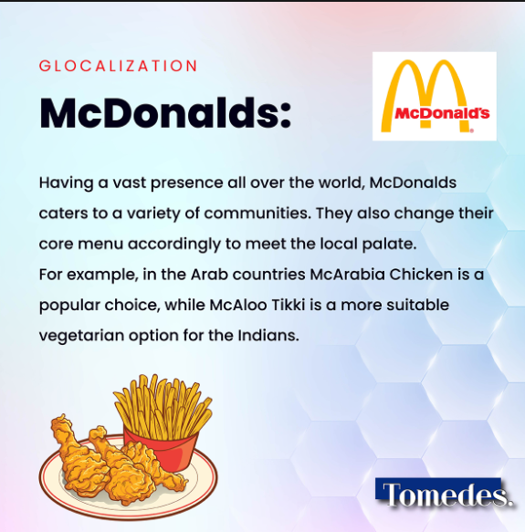



Slide 16
Nature of globalization
Cultural Exchange – Improvement in people to people contacts have encouraged the intermingling of cultural practices and customs. It has allowed people to exchange ideas, behaviors and values with other countries. Communities are less isolated as a result of globalization. For example, several American eateries have penetrated different parts of the world. Similarly, cuisine from far off countries is now readily available in the United States.
Increase in Employment – Every industry is responsible for generating both direct and indirect jobs. And when production increases, it has a positive effect on employment. Globalization helps companies increase their production capacity and set up operations in different parts of the world. It also helps boost work opportunities in countries where these corporations have set up operations.
Increased connectivity between nations – Globalization has helped countries improve trade relations with each other. It has increased interaction between people and businesses. Better connectivity also boosts a country’s economy and enhances the standard of living for its citizens.
Standard of Living – With increased economic activity and opportunities for employment, people have more money in their pockets. They also have more options to choose from because of improved job opportunities. It is one of the main reasons why globalization allows more and more people to improve their standard of living.

Slide 17
Forms of globalization
Economic globalization
Economic globalization is the increasing economic interdependence of national economies across the world through a rapid increase in cross border movement of goods, services, technology and capital.
Economic globalization is the process of increasing economic integration between countries, leading to the emergence of global markets or a single world market. Depending on the paradigm, economic globalization can be viewed as either a positive or a negative phenomenon.
Economic globalization comprises: globalization of production; which refers to the obtainment of goods and services from a particular source from locations around the globe to benefit from difference in cost and quality.
Likewise, it also comprises globalization of markets; which is defined as the union of different and separate markets into a massive global market place.
Economic globalization also includes competition, technology, and corporations and industries.

Slide 18
Contd…
Political globalization
Political globalization refers to the growth of worldwide political system, both in size and complexity. That system includes national governments, their governmental and intergovernmental organizations as well as government independents of global civil society such as international nongovernmental organizations and social movement organizations.
One of the key aspects of the political globalization is the declining importance of the nation state and the rise of other actors on the political scene.
A significant aspect of political globalization is the foundation of a single world government or the promotion of liberal democracy across the world.
There has been a serious attempt by many countries to promote democracy across the world. Even agencies like the World Bank and International Monetary Fund priorities democracy has a condition for the grant of funds to countries.

Slide 19
Contd…
Cultural globalization
Cultural globalization refers to the transmission of ideas, meanings, and values around the world in such a way as to extend and intensify social relations.
This process is marked by the common consumption of cultures that have been diffused by the internet, popular culture media, and international travel.
The circulation of cultures enables individuals to partake in extended social relations that cross national and regional borders.
Cultural globalization involves the formation of shared norms and knowledge with which people associate their individual and collective cultural identities.
It brings increasing interconnectedness among different population and cultures. Cultural globalization can be seen in the promotion of food products and food chains such as Macdonald, Kentucky Fried Chicken (KFC), Coca Cola, Marlboro cigarettes.

Slide 20
Contd…
Environmental globalization
Environmental globalization is simply the consequence of all the after-effects of other types of globalization.
Undoubtedly, the tide of development comes from globalization pollutes the environment. Globalization increases our per capita consumption. This puts a lot of pressure on natural resources, which badly affects the ecological cycle.
Although industrialization is part of globalization, harmful chemicals have been thrown into the environment, affecting the climate dangerously.
Countries worldwide have come to sign climate accords like the Kyoto Protocol and the Paris Climate Agreement to invest in lowering its carbon emissions.

Slide 21
Methods of globalization
Trade: International trade allows countries to exchange goods and services, leading to increased economic interdependence. Trade agreements and organizations like the World Trade Organization (WTO) facilitate this process.
Franchising and Licensing:
Licensing is when one company allows another to use its ideas, logos, or products for a fee. It’s like renting out the rights to something you own. For instance, a company that owns a popular cartoon character might let a toy manufacturer make and sell toys featuring that character. The company giving the permission, called the licensor, usually gets payments called royalties in return.
Franchising is when a company allows someone else to run a business using its name and way of doing things. The person running the business, called the franchisee, pays an initial fee and ongoing royalties to the company, known as the franchisor, for the right to use their brand, trademarks, and systems.
In return, the franchisor provides support, training, and sometimes supplies to ensure all franchise locations are consistent. Franchising is common in industries, like fast food, hotels, and retail, where having the same look and service is important. It lets people start a business with help from an established brand, reducing the risks of starting from scratch.

Slide 22
Contd…
Investment: Foreign Direct Investment (FDI) involves companies or individuals investing in businesses or assets in other countries. This can lead to the creation of jobs and the transfer of technology and expertise.
International Organizations and Agreements: Institutions like the United Nations (UN), International Monetary Fund (IMF), and various regional bodies work to coordinate policies and foster cooperation among nations.
Education: International collaboration in education, including student exchanges and global research partnerships, helps to disseminate knowledge and foster global understanding.
Cultural Exchange: The spread of culture through media, entertainment, and tourism helps to share and blend different cultural practices and ideas. This can be seen in the global influence of movies, music, and cuisine.
Technology and Communication: Advances in technology and communication, such as the internet and social media, enable instantaneous sharing of information and ideas across borders, fostering global connections.

Slide 23
Positive effects of globalization
Access to a Larger Market
The impact of globalization has opened the doors for countries and businesses, allowing them to extend their reach to a broader consumer base. Companies can transcend geographical confines, thereby bolstering sales and revenue.
Globalization's impact has brought virtual highways of global commerce, facilitating seamless transactions and connecting buyers and sellers across continents.
Affordable Goods for Consumers
As companies seek out cost-effective production locations, they optimize their supply chains. The impact of globalization has translated into more affordable products for consumers.
Efficient global logistics, a result of globalization's impact, ensures that everyday goods come with a friendlier price tag.

Slide 24
Positive effects of globalization (contd…)
Specialization
Globalization's impact allows countries to play to their strengths. One nation might import cheap steel while excelling in cutting-edge computer manufacturing. This division of labor, driven by the impact of globalization, enhances overall efficiency and productivity.
Specialization, facilitated by globalization's impact, allows each nation to contribute its unique piece to the global economic puzzle, creating a harmonious symphony of interdependence.
Economic Growth
Globalization is a catalyst for economic expansion, and its impact has been profound. Multinational corporations venture into emerging markets, injecting capital, technology, and expertise.
The impact of globalization translates into job creation, improved living standards, and better wages. The rising tide of globalization lifts many boats.

Slide 25
Negative effects of globalization
Job Displacement
While globalization generates employment opportunities, its impact has also disrupted existing jobs. Certain industries face the brunt of competition from cheaper imports, a direct impact of globalization.
A textile worker in a small town may find herself replaced by automated factories halfway across the globe, a consequence of globalization's far-reaching impact.
Income Inequality
Globalization is not an equalizer, and its impact has been uneven. Wealth accumulates disproportionately in specific regions, leaving others behind—an undeniable impact of globalization.
The gap between the haves and have-nots widens, exacerbating social tensions—a byproduct of globalization’s unbalanced impact.

Slide 26
negative effects of globalization (contd…)
Change in cultural and social value
As cultures collide and blend, some fear the erosion of unique traditions and identities—a cultural impact of globalization. The global conveyor belt of ideas and influences can lead to a uniform global culture.
The vibrant tapestry of local customs risks fading into a monochromatic canvas—an unintended impact of globalization’s pervasive reach.
Environmental Degradation
The wheels of globalization churn relentlessly, fueled by trade and transportation. Yet, this progress takes a toll on the environment—an environmental impact of globalization.
Pollution, deforestation, and climate change are the unintended consequences of our interconnected world, a direct result of globalization's expansive impact. Balancing economic growth with ecological sustainability remains an ongoing challenge in the wake of globalization’s impact.

Slide 27
Foreign direct investment
Foreign direct investment (FDI) is a category of cross-border investment in which an investor resident in one economy establishes a lasting interest in and a significant degree of influence over an enterprise resident in another economy.
FDI is a key element in international economic integration because it creates stable and long-lasting links between economies.
FDI is an important channel for the transfer of technology between countries, promotes international trade through access to foreign markets, and can be an important vehicle for economic development.
The indicators covered in this group are inward and outward values for stocks, flows and income, by partner country and by industry and FDI restrictiveness.

Slide 28
World Trade Organization (WTO)
Created in 1995, the World Trade Organization (WTO) is an international institution that oversees the rules for global trade among nations. It superseded the 1947 General Agreement on Tariffs and Trade (GATT) created in the wake of World War II.
The WTO is based on agreements signed by a majority of the world’s trading nations. The main function of the organization is to help producers of goods and services, as well as exporters and importers, protect and manage their businesses.
The World Trade Organization (WTO) is the only global international organization dealing with the rules of trade between nations.
The WTO has lowered trade barriers and increased trade among member countries. It also has also maintained trade barriers when it makes sense to do so in the global context. The WTO attempts to mediate between nations in order to benefit the global economy.

Slide 29
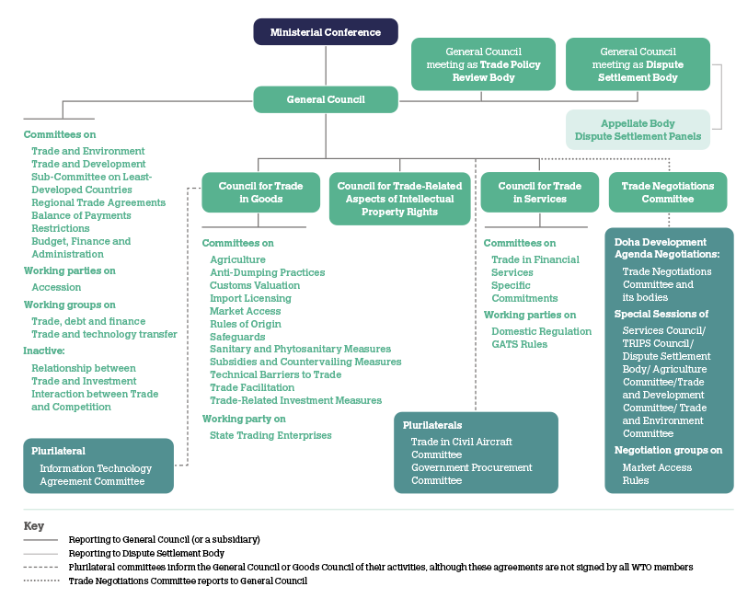

Slide 30
Most favored nation treatment (MFN)
The Most Favored Nation (MFN) treatment is a foundation principle of the World Trade Organization (WTO).
It essentially means that a country cannot discriminate between its trading partners. If a country grants a trade advantage to one country, it must grant the same advantage to all other WTO members.
In simpler terms: Imagine you're selling apples to different countries. If you give a special discount to one country, you must offer the same discount to all other WTO member countries.
Some benefits include:
Increased trade: By reducing trade barriers, MFN treatment can lead to increased trade between countries.
Lower prices: Consumers can benefit from lower prices on goods and services.
Economic growth: Increased trade can stimulate economic growth.

Slide 31
Benefits of WTO Trading System
The system helps promote peace
Disputes are handled constructively
Rules make life easier for all
Freer trade cuts the costs of living
It provides more choice of products and qualities
Trade raises incomes
Trade stimulates economic growth
The basic principles make life more efficient
Governments are shielded from lobbying
The system encourages good government

